Slide 1
A Project Presentation on,
Date: Friday, April 10, 2026
Template Matching
Submitted By
Jahanvi Bagthaliya
MIS. No.: 752562001
Department of Computer Science and Engineering
COEP Tech University, Pune

Slide 2
Content
Learning Objectives
What is Template Matching?
The Sliding Window
Choosing Your “Measuring Tape” (Methods)
Why do we ditch Colour?
Moving Beyond One Match (Thresholding)
Real-World Use Cases
The “Catch” (Limitations)
Code Walkthrough (OpenCV)
Summary & Conclusion
Rule of Thumb

Slide 3
Learning Objectives
Understand the "Sliding Window" logic
Compare different mathematical matching methods (SQDIFF vs. CCORR vs CCOEFF).
Learn why we prioritize grayscale over color images.
Identify real-world scenarios where this beats "Deep Learning.“
Walk through a practical OpenCV implementation.

Slide 4
What is Template Matching?
The Problem: We have a small "target" image and a large "search" image. We need to find the exact x, y coordinates of the target.
The Analogy: Remember the “Hidden Object” games in Champak or Tinkle? You’re given a tiny picture of a Kite and asked to find it in a crowded market scene.
The Reality: In Computer Vision, the computer doesn't "see" a kite; it sees a grid of numbers (pixel intensities) and looks for that specific pattern.

Slide 5
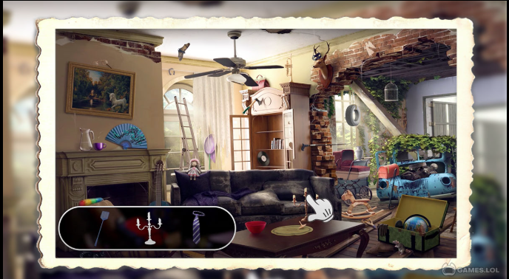
What is Template Matching?

Slide 6
The Sliding Window
Imagine taking your "Kite" cutout and placing it at the top-left corner of the large image.
The algorithm compares the pixels, calculates a "similarity score," and then slides the cutout one pixel to the right.
It repeats this across the entire image, row by row.
The Result Map: This process produces a heatmap. Bright spots (or dark spots, depending on the math) tell us exactly where the template likely sits.

Slide 7
Choosing Your “Measuring Tape” (Methods)
We use different formulas to calculate how “close” a match is:
SQDIFF (Squared Difference): It calculates the difference between pixels. Think of this as a "Penalty Score." A perfect match is 0.
CCORR (Cross-Correlation): It multiplies pixel values. A higher score means a better match. It’s simple but can be fooled by very bright spots.
CCOEFF (Correlation Coefficient): This is the most reliable. It subtracts the average brightness first, making it "blind" to shadows or lighting changes. This is usually our first choice for real-world photos.
Note: We usually use "Normed" versions (0 to 1 range) to make thresholding easier.

Slide 8
Choosing Your “Measuring Tape” (Methods)
OpenCV Method Name | What it measures | Best Match Value | Best Used For...
TM_SQDIFF | Difference | Minimum (0) | Simple, controlled lighting.
TM_CCORR | Overlap | Maximum | Basic patterns.
TM_CCOEFF | Pattern Texture | Maximum | Varying lighting & shadows.
Notes: We usually use the "Normed" versions (like TM_CCOEFF_NORMED). This squeezes the result into a simple 0 to 1 range, making it much easier to understand (0% match to 100% match).

Slide 9
Why do we ditch Colour?
One common question is: "Why convert our Indian Market scene to Grayscale first?“
Efficiency: Color has 3 channels (Red, Green, Blue). Grayscale has 1. Processing in grayscale is 3x faster.
Reliability: Colors shift depending on the time of day or light bulbs used. However, the shape and texture (the edges of the kite) remain the same in grayscale.
Focus: We want the computer to find the "Pattern," not just get distracted by a bright red colour in the background.

Slide 10
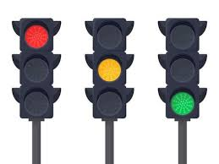
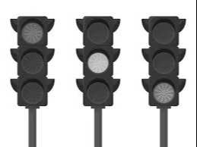
Why do we ditch Colour?
We ditch color because we want the computer to recognize the Identity of the traffic signal (its shape and structure) rather than getting distracted by its Current Color or the lighting of the environment. It makes our detection faster, lighter, and much more reliable.

Slide 11
Moving Beyond One Match (Thresholding)
Sometimes there isn't just one kite; there might be five.
Standard functions like minMaxLoc only find the #1 best match.
The Solution: We set a Threshold (e.g., 0.8 or 80%)
We tell the computer: "Show me every spot on the map where the similarity score is above 80%." This allows us to detect multiple objects simultaneously.

Slide 12
Real-World Use Cases
Where does this actually work in India today?
Manufacturing: Checking if a specific microchip is soldered correctly on a motherboard.
FASTag Systems: Localizing the characters on a dusty license plate at a toll plaza.
UI Automation: Scripts that "find" the 'Submit' button on a website by looking for its specific logo/shape.
Medical Labs: Counting specific types of cells in a blood sample under a microscope.

Slide 13
The “Catch” (Limitations)
As engineers, we must know where our tools fail:
Size Matters (Scale Sensitivity): If your template is small but the object in the photo is large, the match fails. i.e. If your template is 50 x 50 pixels, but the object in the image is 100 x 100 pixels, the algorithm will fail to find it.
Rotation: If the object is tilted even by 15 degrees, the pixel-for-pixel math breaks down.
Obstructions (Blocking): If a bird flies in front of our kite, the similarity score drops significantly, the match might be lost, and the computer gets confused.

Slide 14
Code Walkthrough (OpenCV)
Here is the core logic you'll need for your labs:
Link: Template Matching Demo

Slide 15
Summary & Conclusion
As engineers, we must know where our tools fail:
Template Matching is fast, simple, and requires zero training data.
It is perfect for rigid objects in controlled environments (like factories).
For objects that change shape, size, or angle, we eventually move toward Deep Learning but Template Matching is your essential first step in the world of Object Localization.

Slide 16
Rule of Thumb
Use Template Matching IF... | Switch to AI/Deep Learning IF...
The object is rigid (doesn't change shape). | The object is natural (like a person or dog).
The camera angle and distance are fixed. | The object can be at any distance or angle.
You have very little data (only 1 image). | You have thousands of labeled images.
You need a solution that runs on low power. (CPU) | You have the hardware to run heavy models. (GPU)

Slide 17
Thank you!

